Slide 1
Are You an Accident of Nature?
Part 5
Evolutionist Richard Dawkins
Maybe aliens created life.

Slide 2
Life from Outer Space?
Did aliens plant life on earth?
Notes:
Evolutionists know about this, they just don’t want to face reality. They can’t bring themselves to admit that evidence based reasoning proves life could not happen without God.
So, what do they do?
They guess that life came from outer space – that aliens planted life here.
But this is impossible also – the same problems of information science, entropy, and chemistry prevent life from forming anywhere in any universe.

Slide 3
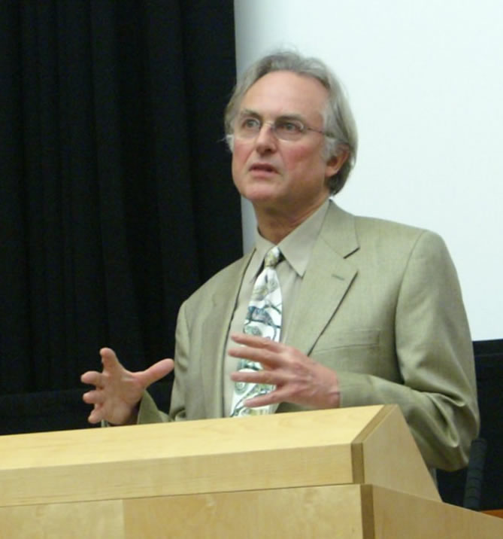
Richard Dawkins
Thinks Intelligent Design a Possibility !!!!!

Slide 4
Film
Expelled:
No Intelligence Allowed
Used by permission of Canadian Friends
Notes:
Grateful to the owners for permission to include this video clip.

Slide 5
Ben Stein’s comment
“Professor Dawkins was not against intelligent design.
Just certain types of designers, such as God.”

Slide 6
Richard Dawkins
“. . . If you look at the details of biochemistry . . . you might find a signature of some sort of designer.”

Slide 7
Richard Dawkins
“Designed a form of life which they perhaps seeded onto this planet.”

Slide 8
Francis Crick
co-discoverer of the structure of the DNA molecule with James D. Watson
Shared Nobel Prize with 2 other men
“for their discoveries concerning the molecular structure of nucleic acids (DNA) and it significance for information transfer in living material”

Slide 9
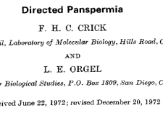

Slide 10
“. . . we have considered Directed Panspermia, the theory that organisms
were deliberately transmitted to the earth
by intelligent beings on another planet. “

Slide 11

Aliens did it!

Slide 12
Richard Dawkins
Can’t Think of an Example of Information Increase in DNA

Slide 13
Give your own presentations.
Free downloads of Powerpoints used in these videos at:
Educate7.com

Slide 14
Next:
Are You an Accident of Nature?
Part 6
No information by chance in any universe

